Slide 2
So who is Ecoforce Global?
Founded in 2020
Focused on capturing CO2 from the atmosphere and repairing soils Multi generational business mission
Multi country / partner strategy to reduce climate change effects
EcoForce uses Affiliate Marketing as its principal method of selling trees Ecoforce has a strong Social Conscience and supports NFP’s worldwide
FOUNDERS:
Charles & Tracy Alder

Slide 3
First Hand Experience
Built Rural Aid from nothing to a $100 Million dollar charity Over 14,000 farmers requested assistance over 7 years. Assistance for Flood, Bushfire and Drought provided to farmers Farmers across all states and different primary production categories Funded soil case studies with Soils for Life
Problem Long term charitable support for rural producers is unsustainable. It’s impossible to provide enough hay, water, financial assistance to support a producer.
Solution Engage consumers in the climate conversation, empower them to be a part of the solution and work with farmers who have access to the land to repair soils & capture carbon.

Slide 4
The Solution? Plant trees. Billions of them!
Trees regulate the water cycle Trees provide jobs
Trees are vital to habitat for wildlife Trees improve soil quality
Trees prevent erosion Trees provide shade
Trees capture and store carbon
Finally, trees create oxygen for us all to breathe

Slide 5
Our environment today...Our Challenge
Carbon is a major factor in global warming
Deforestation We are cutting trees down faster than we are replacing them
Clearing & Overgrazing We’re clearing land at increasing rates to keep up food production and losing up to 24 billion tonnes of fertile soil per year
Ocean temperatures are increasing with greater levels of carbon in the water leading to coral bleaching and reef damage

Slide 6
So how big is the opportunity?
3 Billion at least!
Africa ... to reverse desertification & stop expanding deserts
Australia ... to repair soils after drought and fires
USA ... to replace trees destroyed in California fires
Brazil ... to replace those cut and burnt in the Amazon Every country has a need for trees

Slide 7
So where will we plant these trees?
On farmland ... We’ll partner with farmers to capture CO2
Regen Ag ... The farmers will adopt Regenerative Ag processes ad sequester carbon in trees and soil
Planters ... We’ll work with NFP & tree planters & professional planters
Species ... Provenance, climate, farm needs, CO2 & soil type are all part of the tree selection.

Slide 8
EcoForce Land Owner Partnership proposal.
Steps 1. Farmer is interested in planting trees and adopting Regen Ag principles, farmer registers. 2. EcoForce connects, seeks information about soil type, native tree species, availability of seeds, agreeable tree volume. 3. EcoForce draws up Regen Action Plan (RAP) that contains a 2 year costed pathway to regen. Included in the plan is an agreement to reimburse producers $4 a year per tree planted and maintained to be reimbursed against listed items in the RAP 4. Farmer signs off on tree numbers, $4 per tree per year, 2 x $2 instalments on provision of report to EcoForce of tree growth. 5. EcoForce contracts local NFP to plant the tree @ $3 a tree or pays farmer or tree planter. 6. Trees are ordered from available source and planting timetable set in place 7. Prior to planting EcoForce soil carbon measurement partner measure soil carbon level to create a baseline. This measurement is also taken at the end of year 2

Slide 9
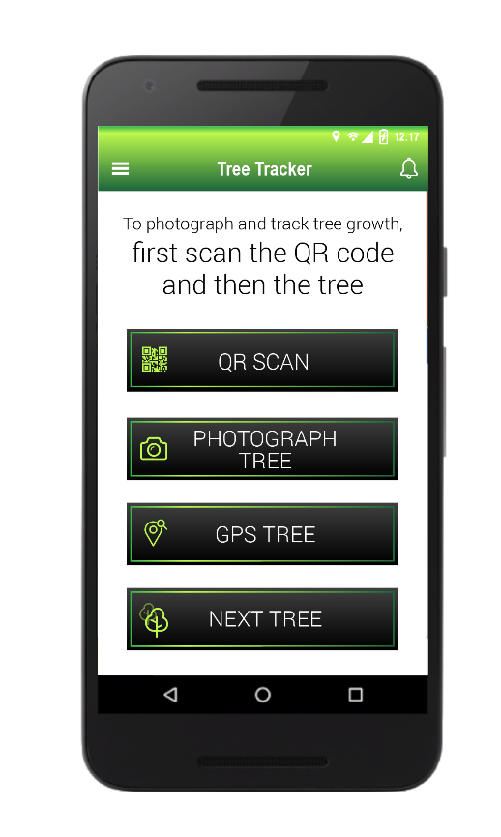
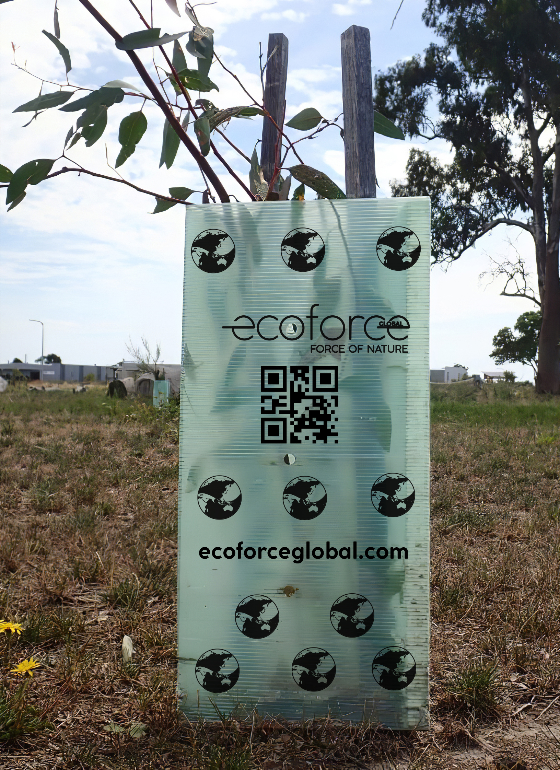
EcoForce Measurement and Reporting.
Steps 1. Farmer reports on growth of trees each 6 months by scanning the tree guard QR code through an app , photographing the tree and uploading the data to EcoForce. 2. EcoForce connects, the upload data to the consumer or corporate who purchased the tree reporting its growth, estimated carbon captured amount, GPS location and update from the farmer as to their progression towards Regen 3. If a tree dies EcoForce agrees to replace the seedling and the farmer replants.
4. At the point of uploading the data, EcoForce issues funds to cover invoices received for reimbursement as per the RAP on the $2 per half year agreement. 5. At the conclusion of the 2 years, EcoForce will have made 4 payments to the farmer and the soil carbon measurement final reading is taken.

Slide 10
Financial Model.
1. Trees are sourced at commercial rates from nurseries. 2. EcoForce pays $3 AUD for the planting of each tree incl tree guard and hole drilling 3. EcoForce supports the farmer with $4 a year in reimbursement for RAP agreed expenses. 4. Disbursements are paid on receipt of a completed 6 monthly report.
5000 Trees - Farmer - $20,000 a year - $40,000 over two years 10,000 Trees - Farmer - $40,000 a year - $80,000 over two years

Slide 11
Some Key Points.
1. The trees are gifted to the farmer by the purchaser. 2. Trees must be maintained by the farmer to receive reimbursement, a dead tree whilst replaced is forfeited for that 6 month period. 3. Trees are chosen based upon native status. Where some countries have mainly fruit or edible produce trees native to that environment, planting of these can be negotiated. 4. Farmers have no cost to bear for the trees nor carbon measurement process. 5. Carbon credits are not included in the equation. Our partner will negotiate a separate deal for credits.

Slide 12
FAQ.
Landholders
As a Landowner/Farmer, what is the minimum number of trees I can plant to be eligible for the ‘Tree Planting Program?
The minimum number of trees is 2500.
What sort of trees will you plant?
It is important to plant to most suitable trees for the planting sites. Many of our planting sites will be on private land so the selection of trees will be done in consultation with the landowner and the local landcare specialists and tree planting organisations. The tree types will also be chosen to maximise carbon capture and soil health growth.
How will EcoForce support my farming business?
In Australia 60% of all land is held by farmers. If EcoForce can plant trees on these properties and help sequester ( capture) carbon and in turn help rebuild soil health and mineral content then why not support farmers?
Can landowners anywhere in the world participate?
EcoForce will work with landowners in most countries of the world to plant trees. Australia, New Zealand, United States and the United Kingdom will be the first countries where we will consider tree plantings.
Do I need to have an understanding of regenerative agriculture to be considered?
No, EcoForce will work with any farmer who wishes to move to a regenerative agriculture basis. We will help fund appropriate training courses to begin your regen ag understanding.

Slide 13
FAQ
Landholders
What will happen if the trees then become considered high value regrowth at anytime after the 2 year period?
The trees become the property of the landholder after the 2 year contract period and therefore, any additional income earned belongs to the landholder.
How are the planting of trees prioritised?
We are partnering with landholders on the basis of first come, first served.
Who determines what species of trees are planted?
It is important to plant the most suitable trees for the planting sites. Many of our planting sites will be on private land so the selection of trees will be done in consultation with the landowner and the local Landcare specialists, tree planting organisations and Natural Resources Management (NRM) organisations. The tree types will also be chosen to maximise carbon capture and soil health growth.
What happens if a landowner experiences a loss of tree through fire or flood and who is responsible for replanting the trees?
Ecoforce will supply new seedlings to replace those seedlings or trees destroyed by fire or flood. Replanting the replacement tree will be the responsibility of the landowner.
Who is responsible for watering the trees?
It is the responsibility of the land owner to ensure the trees are watered.

Slide 14
FAQ
Landholders
Does it have to be a new planted tree, or can passive regrowth trees be considered as part of the Ecoforce Tree Planting Program?
Ecoforce will plant new physical Trees only.
How will Ecoforce monitor the trees progress over the two year period?
Landholders will be required to scan a QR code that is assigned to each tree, and photograph each tree at four 6 Monthly intervals over the 2 year period. This process unlocks funding at each of the four intervals of the QR code scanning & photographic process. Ecoforce will also have field staff to complete spot checks in the plantations and be available to support and provide advice.
Will cropping and grazing be considered a part of regenerative agriculture?
Yes, both can be a consideration as part of the program.
Next Step – Register at https://www.ecoforceglobal.com/landowners/

Slide 15
Charles Alder CEO / CVO charles.alder@ecoforceglobal.com

